Slide 1
Globus File Transfer for Common Crawl
Big Data Analytics

Slide 2
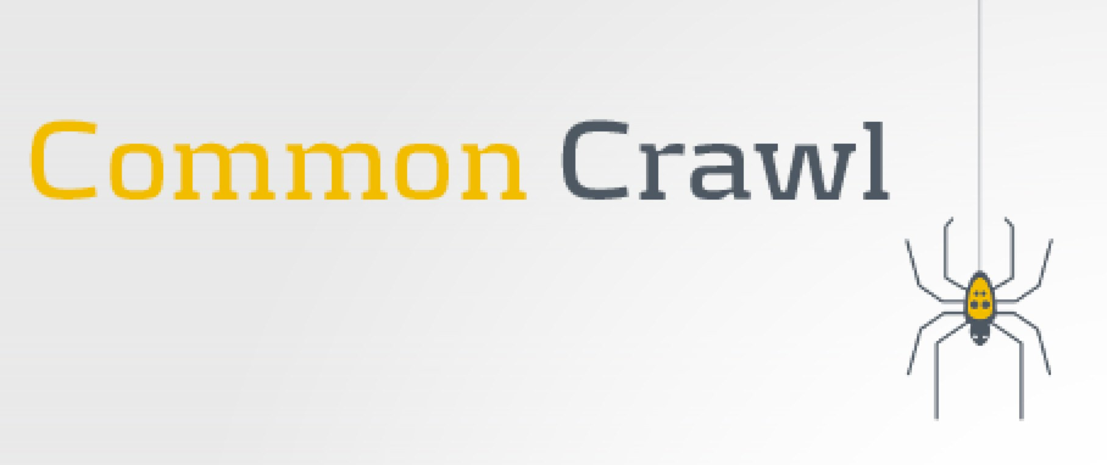
Introduction
The Common Crawl is an open repository of web crawl data collected over last 7 years which contains several petabytes of data.
It has web page data, meta data extracts and text extracts
The data is stored in WET, WARC and WAT file formats
Stored as chunks of data on Amazon Web Services - Public Data Sets across multiple academic cloud platforms.
We need this data for 2 Big Data Processing Projects:
LORELEI language classification
Biological Data classification
Globus File Transfer is needed to transfer the data to the Pittsburgh Supercomputing Center (PSC) for carrying out experiments in the above mentioned projects.

Slide 3

ABOUT - Globus File Transfer
The Globus transfer service provides high-performance, secure, file transfer and synchronization between endpoints. [Globus]
Features of Globus:
Recover from transfer failures due to network unreliability
Ensure integrity of transferred files
Maintain required levels of security
Can deal with different security configurations between resources
In- place sharing of data
Interfaces provided - web browser and command line
Maximizes bandwidth usage
Notifies about transfer completion and problems
Software as a Services (SaaS)

Slide 4
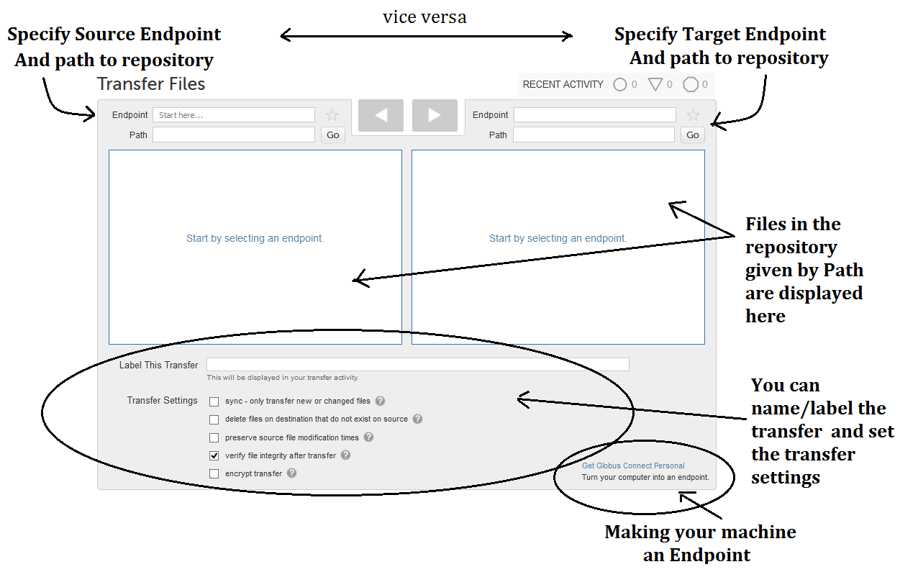
Initial Experiments with Globus Web Interface
Transferred data between PSC Bridges endpoint and our own PC using the web browser.
Realised the need for an API to transfer larger chunks of data at a time. (Especially because the transfer would not be between PCs and dummy end points, but between PSC and Common crawl AWS s3 endpoints)

Slide 5
Experiments with Globus SDK for Python
The Globus SDK is a Pythonic REST based API
Provides Transfer API and Globus Auth API used to transfer files between two resources with different security configurations
Endpoint IDs of the source and destination needed by Transfer Client.
Authentication and transfer tokens needed to accomplish transfer.
Tokens expire every 48 hours. Need to be refreshed.
PSC requires certain configurations. Globus SDK was not able to transfer efficiently due to these constraints.
Dropped the idea of using any form of APIs till we figured out the transfer protocols of PSC.

Slide 6
Common Crawl S3 Endpoint
Globus transfer is done between endpoints.
Common Crawl bucket S3 endpoint -> PSC Bridges endpoint
Creating endpoint requires a Globus subscription
Joined XSEDE Plus Sponsors group
S3 Endpoint is a managed endpoint, one has to be a subscription manager to create an S3 endpoint.
Derek Simmel from PSC Bridges created one and gave us the permission to access it.
https://docs.globus.org/how-to/amazon-aws-s3-endpoints/
Each month’s data is at least 50 TB and some cases it was higher than 100 TB. We can estimate the corpus to be around 2 Petabytes (can be much higher).
Requires more space on PSC Bridges to run the experiments.

Slide 7
How to create the endpoint?
Can only be done from a subscription manager account (since S3 endpoint is a managed endpoint)
https://docs.globus.org/how-to/amazon-aws-s3-endpoints/
In Part A, skip steps 2-6 (Creating a policy) - standard policy available works
In Part A, steps 7-13 (Creating a role): step 12 (Attach Policy Page): add AmazonS3ReadOnlyAccess - the ARN for this is arn:aws:iam::aws:policy/AmazonS3ReadOnlyAccess
In Part B, step 2 (specifying the region specific URL for the S3 bucket): Use the following link https://s3.amazonaws.com/aws-publicdatasets
Then, activate the endpoint and test it out from web interface or the CLI.

Slide 8
Data Transfer
Current transfer speed is low : 25-50 Mb/s
Need to setup parallel transfers from multiple globus accounts.
August 2016, July 2016 data downloaded by Derek to pylon2.
We didn’t have the storage space to download that scale of data.
Used web interface for the transfer.

